Slide 1

Two-Dimensional Memtransistors: Modeling and Simulation for Circuit Design
ASGAR ALI M.Tech VLSI DESIGN
2024PVL0094
M.Tech Student Department of Electrical Engineering
IIT Jammu
Under the Guidance of: Dr.Chandan Yadav

Slide 2
Table of Contents
¹ Introduction
² Need and Motivation
³ Literature Review
⁴ Research Gaps
⁵ Current Work
⁶ Simulation result
⁷ Post Programing pulse state
⁸ Challenges in Current Work
⁹ Outline of the Next Research Plan
¹⁰ References

Slide 3
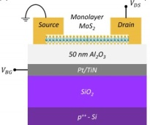
Introduction
Memtransistor Structure : A three-terminal hybrid device (source, drain, gate) that merges memristor’s non-volatile memory with transistor’s gate-tunable conductance.
Independent Read/Write: The gate terminal lets us control reading and writing separately, unlike memristors.
Enhanced Functionality : Works as both memory and logic helps overcome the von Neumann bottleneck by reducing the gap between memory and processor.
Reduced Complexity: Memtransistors eliminate the need for extra selector transistors that are required in memristor crossbar arrays to access individual memory cells. This leads to more area- and energy-efficient designs.
Figure: 2D Back gated memtransistor[1]

Slide 4
Need and Motivation
Need of Memtransistor
The von Neumann Bottleneck : In traditional computers, CPU and memory are separate. Continuous data transfer between them slows performance and wastes energy.
Energy Challenge : For data-heavy tasks (e.g., AI, ML), this back-and-forth consumes enormous energy.
Need for In-Memory Computing: To solve this, computation must happen inside the memory itself, reducing data movement and improving efficiency.
Motivation
By developing memtransistor-based systems, we can enable faster, smarter, and energy-efficient electronics for future AI and IoT applications.
High Scalability : The use of atomically thin MoS2 allows for aggressive dimensional scaling. Brain-inspired neuromorphic computing for applications like real-time seizure detection.
Chip Fingerprints (PUFs): Tiny, unavoidable variations during the manufacturing of MoS2 create a unique physical ”fingerprint” for every single chip. This identity is impossible to clone, preventing counterfeit copies.

Slide 5
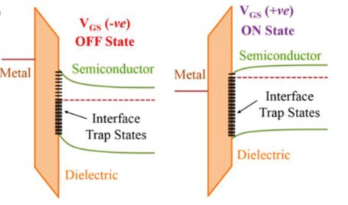
Literature Review
Working Mechanism of Memtransistors
Operate mainly through charge trapping at MoS2/oxide interface and in oxide near interface (storing charges in traps) or resistive switching (changing resistance states).
These mechanisms allow them to store information non-volatilely.
Role of 2D Materials
Molybdenum Disulfide (MoS2) is one of the most promising channel materials for memtransistors.
Its atomically thin structure makes it suitable for ultra-scaled devices. MoS2 is only 0.7 nm thick (monolayer).
Enables smaller and denser devices compared to silicon.
Figure: Trapping and Detrapping[3]

Slide 6
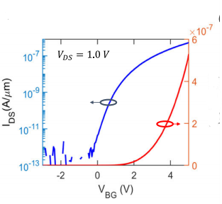
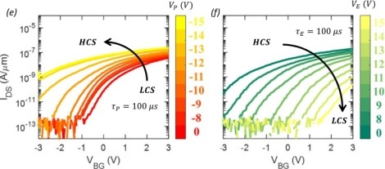
Cont.
Hardware implementation of Bayesian network based on two-dimensional memtransistors
(Publication: Nature Communications (2022)
Figure: 2D-MoS2 based Memtransistor[1]
Figure: Id vs Vgs post programming pulse
.Experimentalresult Log scale(X axis: gate voltage, Y axis Drain current)[1]
Figure: Transfer characteristics, i.e., source-to-drain current (IDS) vs(VBG), (VDS) of 1 V, in
linear and logarithmic scale[1]
Channel: Monolayer Molybdenum Disulfide (MoS2) .
Gate: A local back-gate structure with a 50 nm Aluminum Oxide (Al2O3) charge trapping dielectric on a 40/30 nm Platinum/Titanium Nitride (Pt/TiN) electrode.
Contacts: Nickel (Ni) and Gold (Au) are used for the source and drain. Substrate: The device is built on a SiO2/p++-Si substrate.

Slide 7
Dielectric Engineering: HfO₂ vs. Al₂O₃
Stronger Gate Control (High-k Effect): HfO2 possesses higher dielectric constant (ϵr ) this significantly increases the gate capacitance, allowing the stronger gate control over the remote MoS2 channel.
Intrinsic Defectivity: The crystal structure of HfO2 is inherently unstable, making it highly prone to forming stable oxygen vacancies during deposition.
Enhanced memory window: These structural vacancies in HfO2 function as deep bulk
charge traps, enabling a far higher volume of storage and hence increase memory window.
Key Advantage of Al2O3 over HfO2 : Due to Al2O3 large bandgap ( 8.8eV), which minimizes leakage current and ensure stable conductance state.

Slide 8
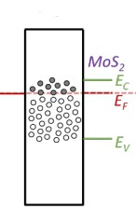
Interface traps and bulk traps
Interface Traps state At MoS2/HfO2: These traps sit directly at the MoS2–HfO2 interface and interact instantly with the channel through SRH capture/emission. They mainly degrade current and mobility but cannot store charge for long.
Oxide Traps state :
Located within the HfO2 dielectric volume, physically separated from the MoS2 bands. Can retain charge for long periods, making them the dominant mechanism enabling stable, non-volatile memory storage.
Figure: Interface trap states[2]
Figure: Oxide trap states[1]

Slide 9
Research Gaps
Experimental-Based Challenges
It’s still hard to make large, uniform, defect-free wafers of 2D materials like MoS2 Fabrication imperfections cause variability in performance(Device to Device).
Forming low-resistance electrical contacts with atomically thin channels is difficult.High contact resistance wastes power and reduces speed,performance.
Simulation-Based Research Gaps
Need precise modeling of material properties and interface physics before fabrication .
Need models that capture charge traps, contact resistance, and defects to bridge the gap between ideal simulations and experiments.

Slide 10
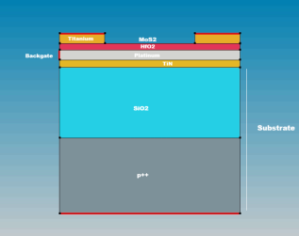
Current work
Device structure :
The device is a three-terminal transistor-like structure based on monolayer MoS2.. Substrate (SiO2 / p++Si) 285 nm SiO2 grown on heavily doped p++ silicon.
Local Back-Gate (Pt 40nm TiN 3Onm with HfO2 25nm): The back-gate terminal is where programming and erasing pulses are applied.
Channel (Monolayer MoS2 0.65nm): 2D material thickness (sub-nm scale) ensures excellent gate electrostatics.
A 40nm Titanium metal is used as source and drain .
Figure: 2D Device structure sde

Slide 11
TCAD Physics models used
Trap Location | TCAD Model | Role in Operation | Trapping Physics | Parameters Used
MoS₂/HfO₂ Interface | Donor uniform, Acceptor uniform (10¹² cm⁻²) | Primary function is to cause mobility degradation. | Shockley–Read–Hall (SRH) kinetics (local capture) | 1.0 × 10⁻¹⁵ cm² cross-sections
HfO₂ Bulk (25 nm) | Acceptor Gaussian (e⁻ trap) | Erase operation; stores negative charge (5 × 10¹⁸ cm⁻³) | eBarrierTunneling Poole–Frenkel (Detrapping) | E_{mid} = 1.0 eV from E_{C}
HfO₂ Bulk (25 nm) | Donor Gaussian (h⁺ trap) | Program operation; stores positive charge (1 × 10¹⁸ cm⁻³) | hBarrierTunneling and Poole–Frenkel (Detrapping) | E_{mid} = 1.5 eV from E_{V}
Table: Summary of trap locations, TCAD models, trapping physics, and parameters used.

Slide 12
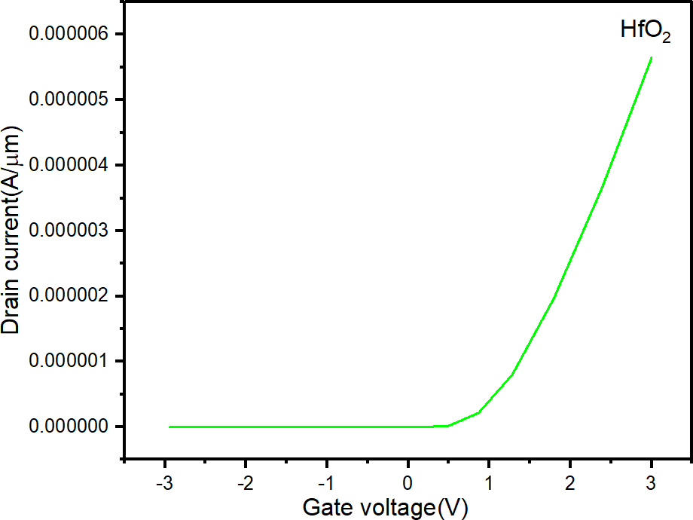
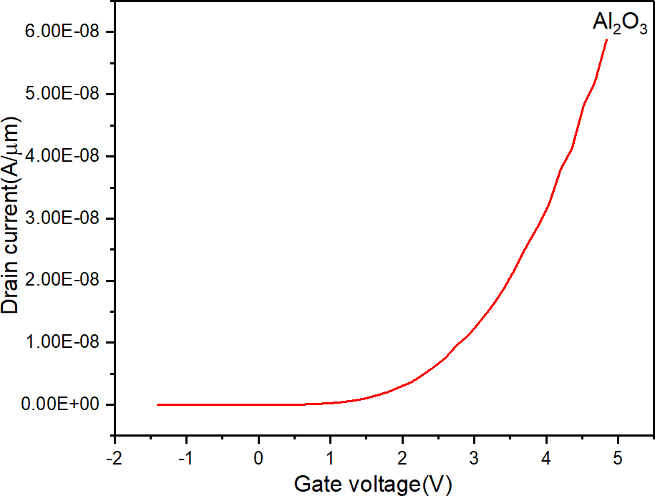
Simulation result
Id vs Vgs characteristic
Parameter | Al2 O3 Device | HfO2 Device
Permittivity (εr ) | ≈ 9 | ≈ 25
Threshold Voltage (V_{th}) | ≈ 1.7 V | Lower 1.2V
ION | ≈ 6 × 10⁻⁷ A/µm | 1×10⁻⁵ A/µm
IOFF | ≈ 10⁻¹³ A/µm | slightly higher 10⁻¹¹ A/µm
Table: Comparison of Al2 O3 and HfO2 Devices
Figure: Ids vs Vgs linear scale
Figure: Id vs Vgs linear scale

Slide 13
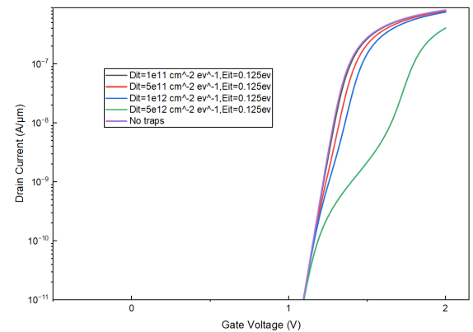
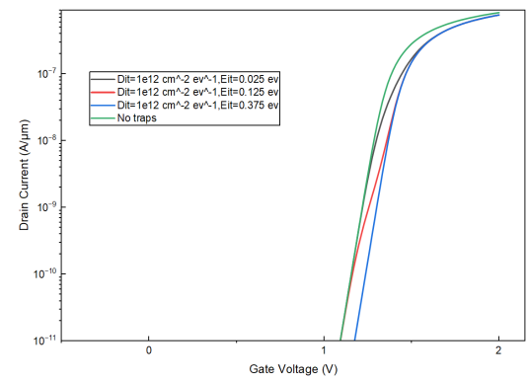
Id vs Vgs characteristic at different trap concentration
Id vs Vgs characteristic
Varied the trap concentration in the HfO2 bulk. Gate voltage sweep from -2v to 3v with Vds=0.05v..
Figure: drain current against TCAD
simulation data at different values of Eit
Figure: Drain current against TCAD
simulation data at different values of Dit

Slide 14
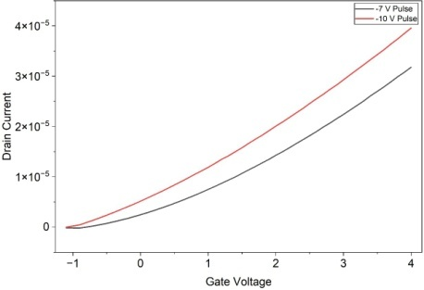
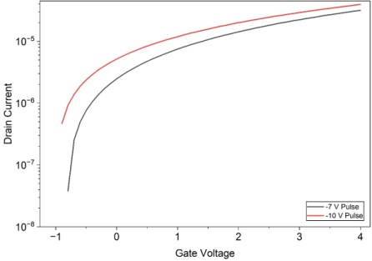
Post Programing pulse state
VP voltage pulses of different amplitudes -7 V to -10 V applied to the local back-gate electrode, each for a duration of P=E = 100 µs,
Post progammed state Id vs Vgs . .
Figure: Ids vs Vgs linear scale post program state
Figure: Id vs Vgs log scale post program state

Slide 15
Challenges in Current work
The following are the current challenges:.
It’s very difficult for the simulation to accurately capture the effect of very fast and powerful voltage pulses (programing and erase).
Creating a mesh that is fine enough for numerical stability without making computational cost .
Non linear physics causes the solution to diverge rapidly.

Slide 16
References I
[1] Zheng, Y., Ravichandran, H., Schranghamer, T.F. et al. Hardware implementation of Bayesian network based on two-dimensional memtransistors. Nat Commun 13, 5578 (2022). https://doi.org/10.1038/s41467-022-33053-x
[2] Logic Locking of Integrated Circuits Enabled by Nanoscale MoS2-Based Memtransistors Shakya Chakrabarti, Akshay Wali, Harikrishnan
Ravichandran, Shamik Kundu, Thomas F. Schranghamer, Kanad Basu, and Saptarshi Das ACS Applied Nano Materials 2022 5 (10), 14447-14455 DOI: 10.1021/acsanm.2c02807
[3] Smithson, S. C., Onizawa, N., Meyer, B. H., Gross, W. J. Hanyu, T. Efficient CMOS Invertible Logic Using Stochastic Computing. IEEE Trans.
Circuits Syst. I: Regul. Pap. 66, 2263–2274 (2019).
[4] Boyan Jin, Zhenlong Wang, Tianyu Wang, Jialin Meng, Memristor-Based Artificial Neural Networks for Hardware Neuromorphic Computing, Research, 10.34133/research.0758, 8, (2025).

